Slide 1
Car rental system GETCAR
Syrym Shotan ITSE-1907

Slide 2

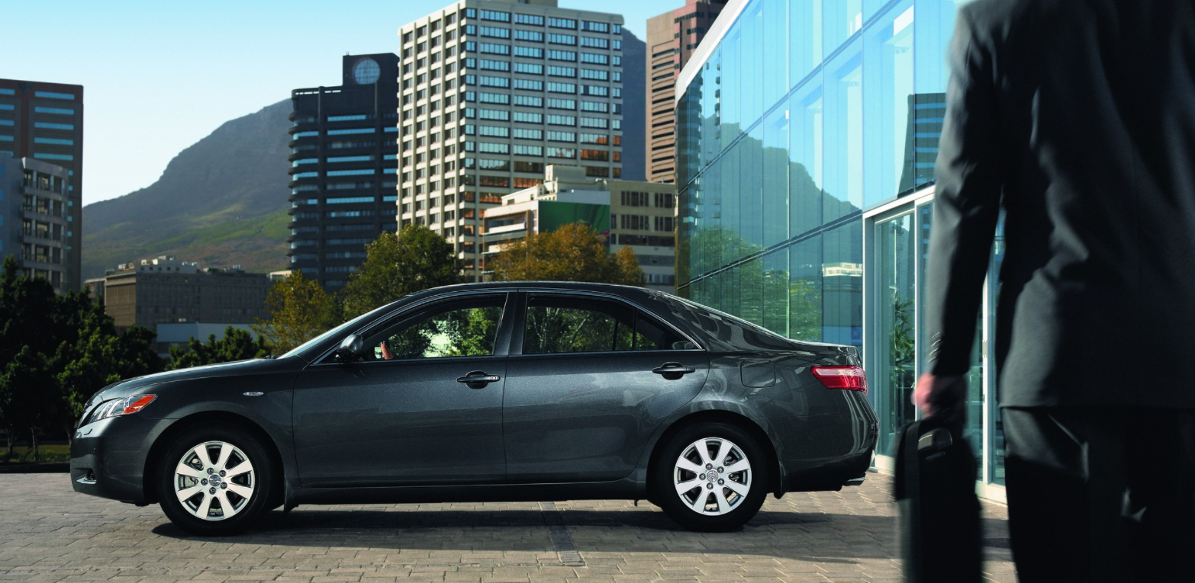
Content
Review
Problem analysis
Project objective
Target audience

Slide 3
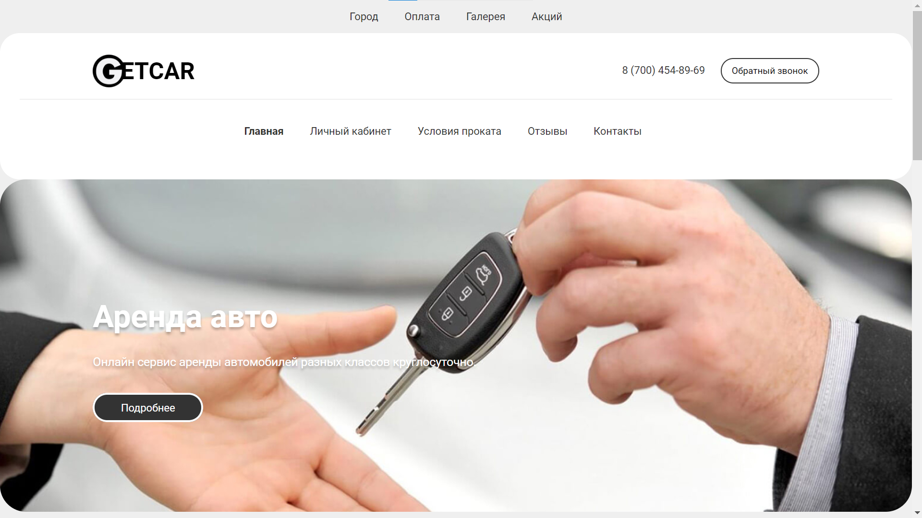
GETCAR
The car rental project is a website where you can search for a car for rent in Almaty.
Car rental system is the most profitable way to travel without a personal car. This service will help you save money on city trips. You do not need to look for a taxi or order a taxi to transport things or go somewhere. Thus, car rental is unpretentious in any city.

Slide 4


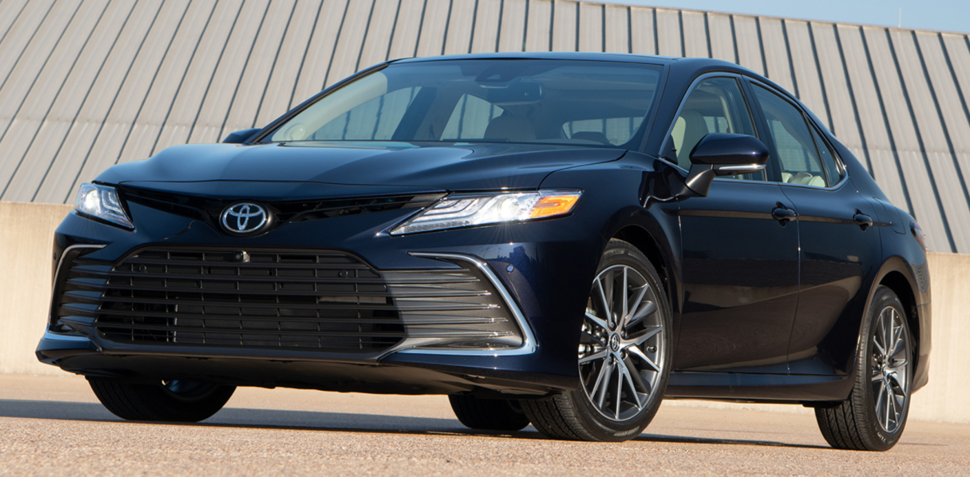
Problem analysis
There are few such services
Incomprehensible and inconvenient interface
Without the possibility of registration
It will take too much time

Slide 5
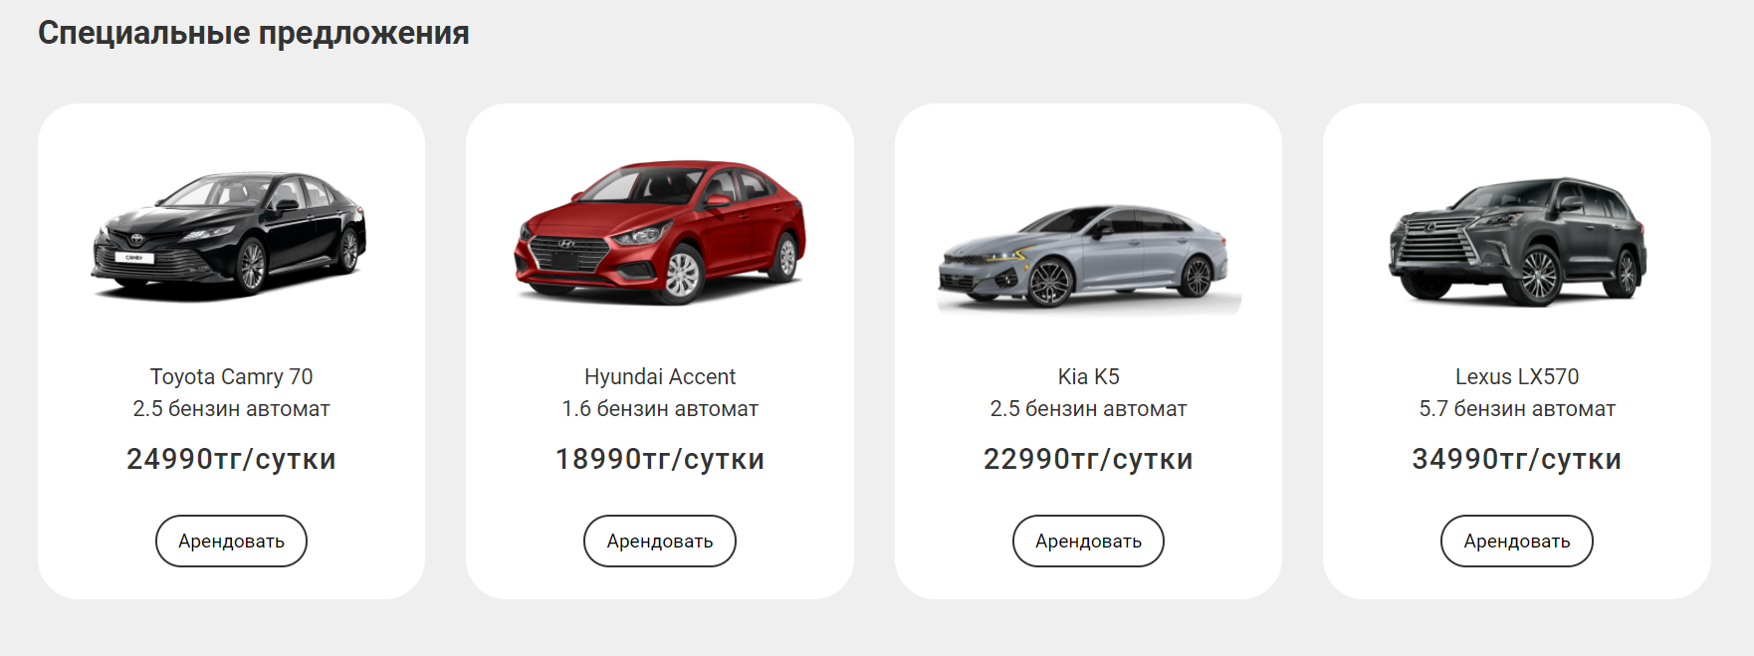
Project objective
Help renters decide on the price
Help pick up a car
Provide the opportunity to book
Possibility of registration

Slide 6

Project relevance
Here you can choose the necessary car model for all occasions. If you value an increased level of comfort, or prefer reasonable savings - we will be happy to offer you exactly what you need. Among other things, our company offers car rental in Almaty without a driver, which is an extremely convenient solution for those who like to drive a car for their own pleasure. Our goal is your comfort and safety in any situation!

Slide 7


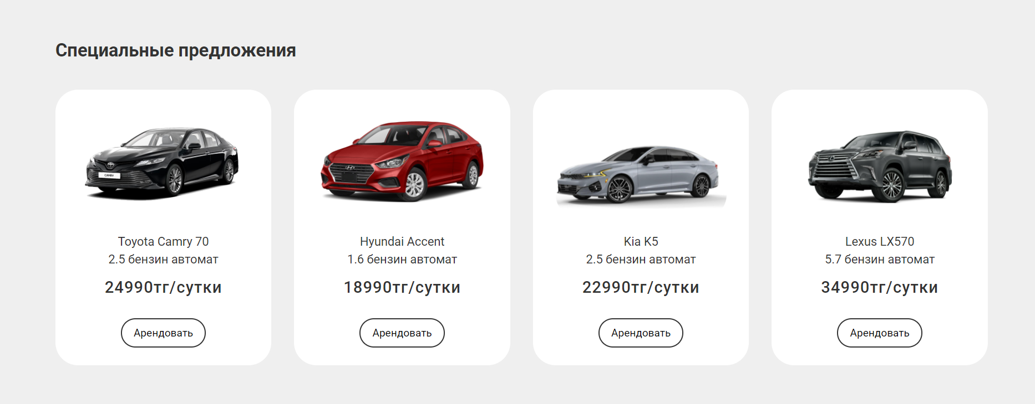

Slide 8
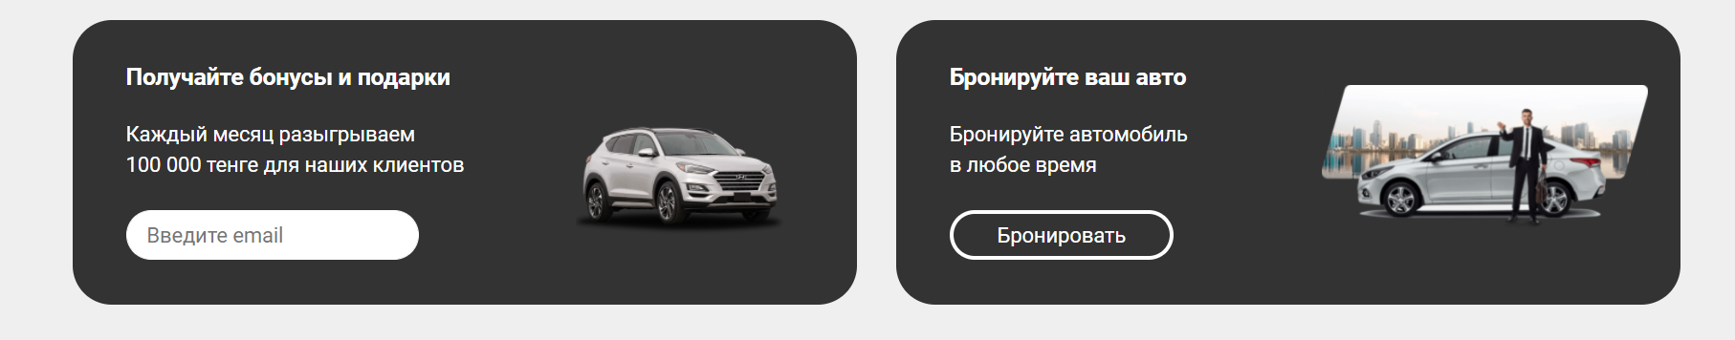
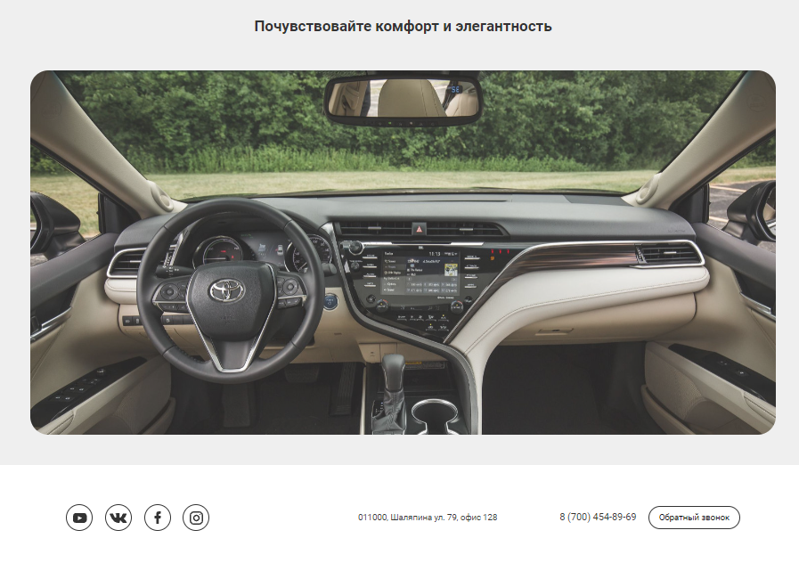
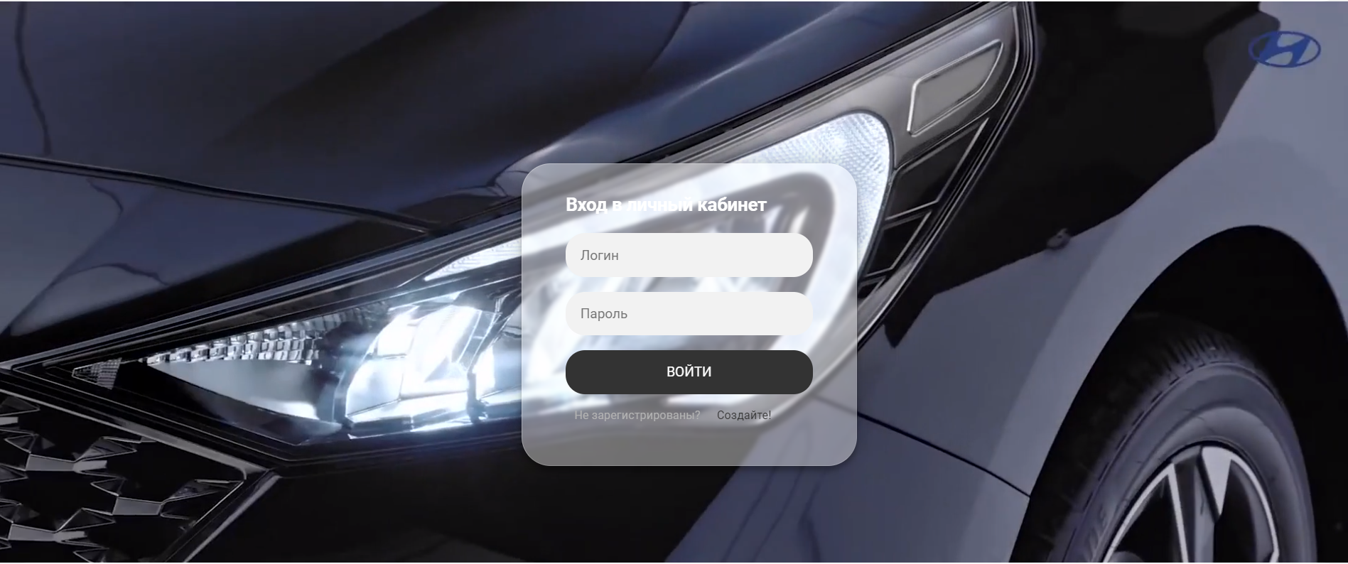

Slide 9
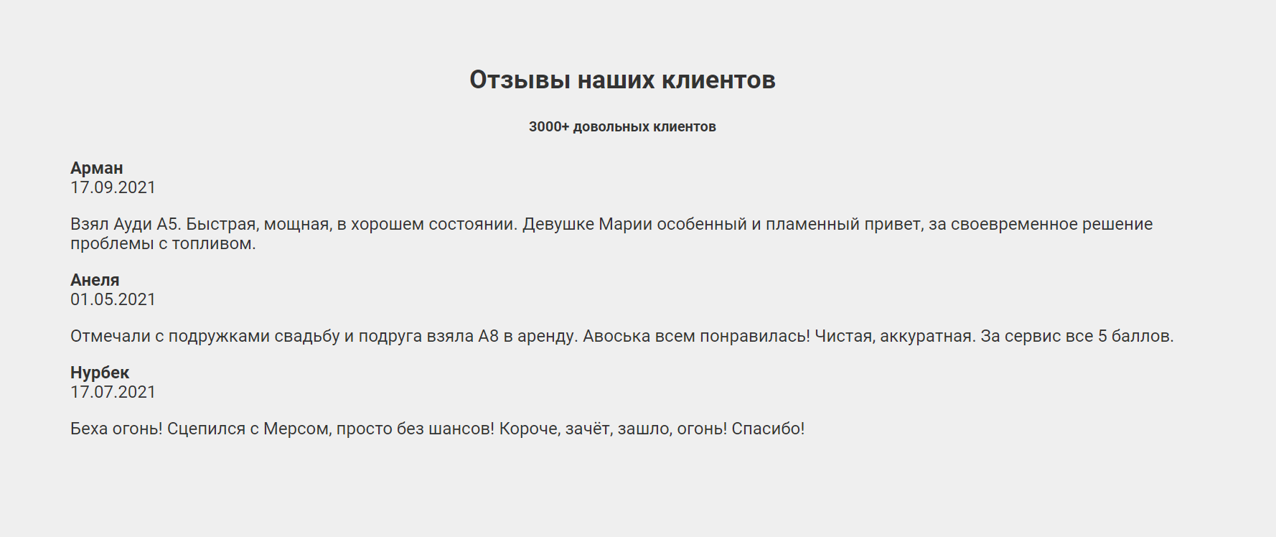
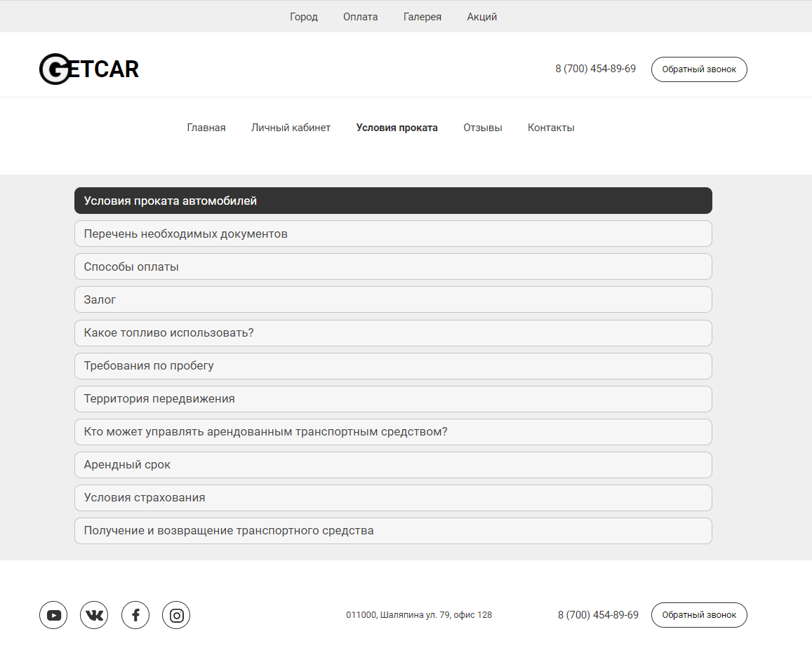
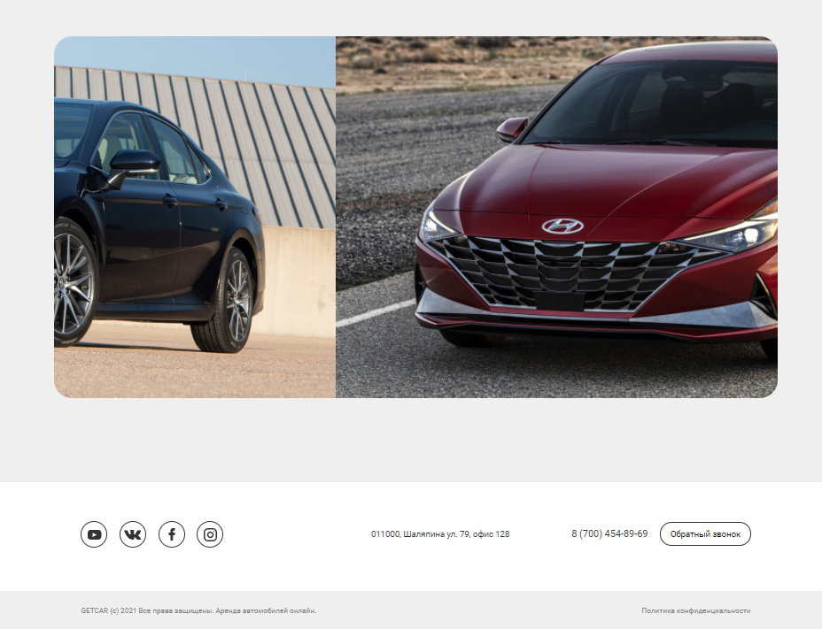

Slide 10
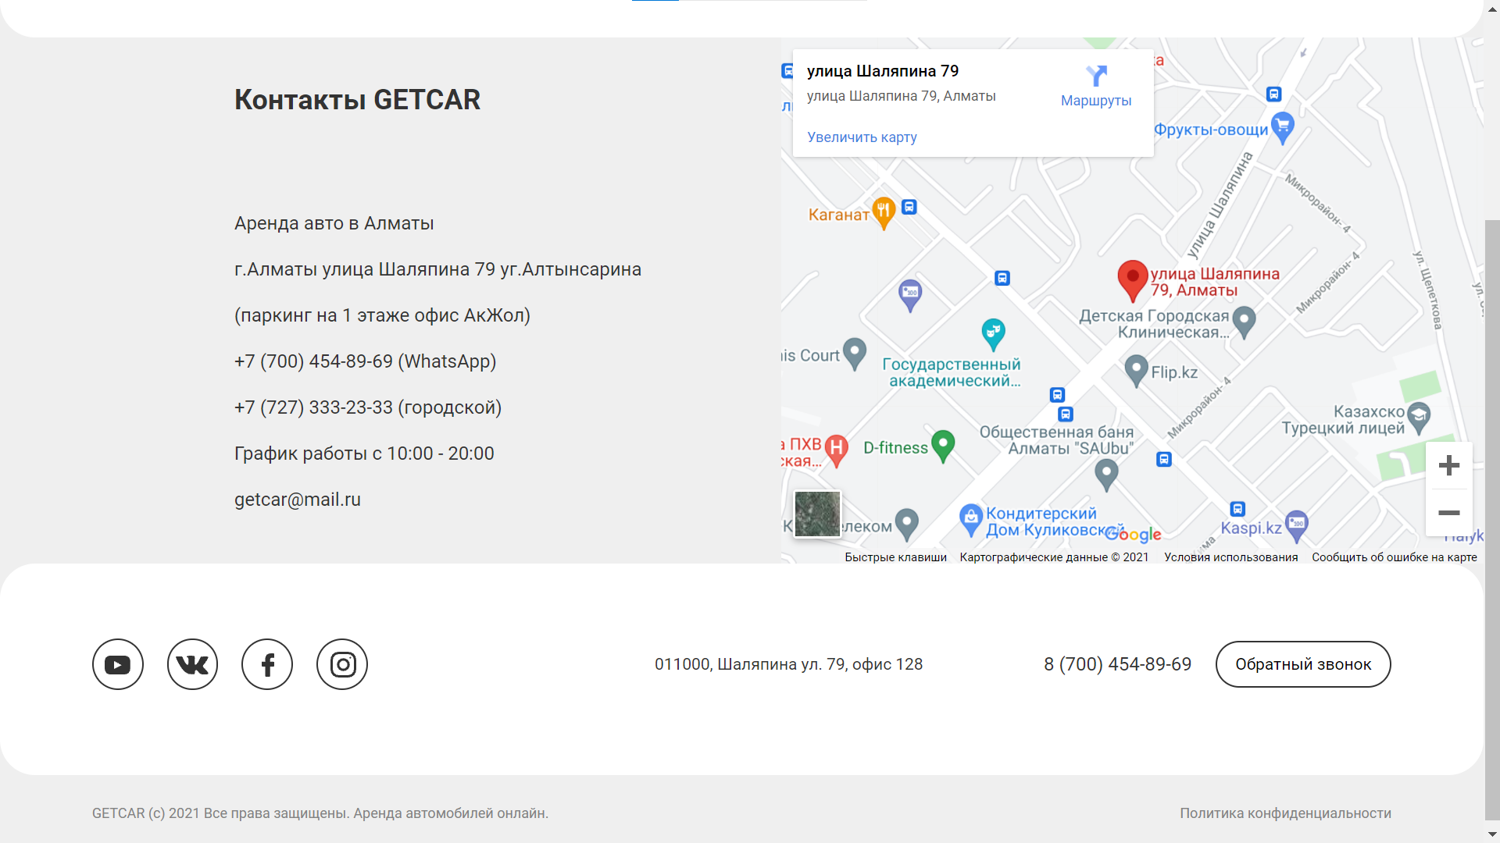

Slide 11
Thanks for your attention!
Shotan Syrym ITSE-1907

